Slide 1
Program Quad Demo
MILTECH

Slide 2
Program Quad Steps
SSO Creates New Program Quad
SSO Assigns/Updates User Permissions for Designated Programs
SSO Assigns/Updates Funding for Program
SSO Assigns/Updates Procurement Quantities for Program
SSO Assigns/Updates AAO, APO, Inventories for Program
SSO Updates Sections of Program Quad
SSO Downloads Program PowerPoint Slides

Slide 3
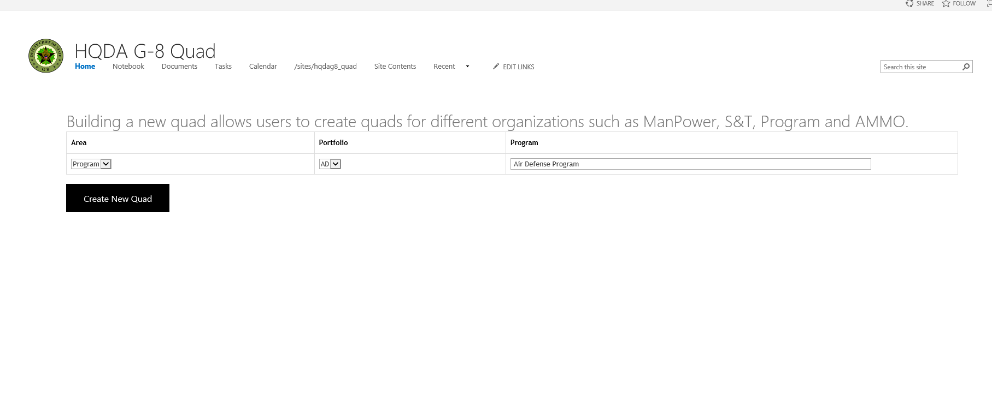
1. SSO Creates New Program Quad
SSO Creates New Program Quad

Slide 4
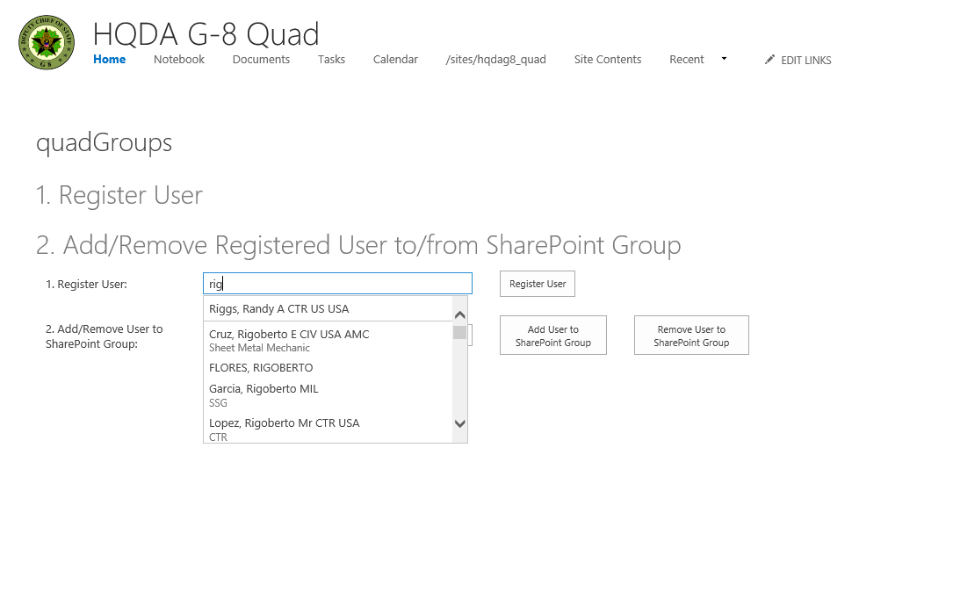
2. SSO Assigns/Updates User Permissions for Designated Programs
SSO Registers and Assign Users
SSO Add/Remove User(s) to Program Groups

Slide 5
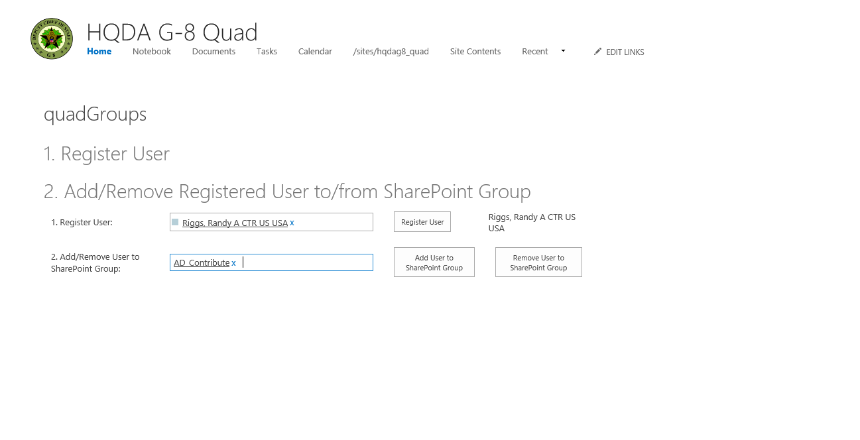
2. SSO Assigns/Updates User Permissions for Designated Programs(cont...)

Slide 6
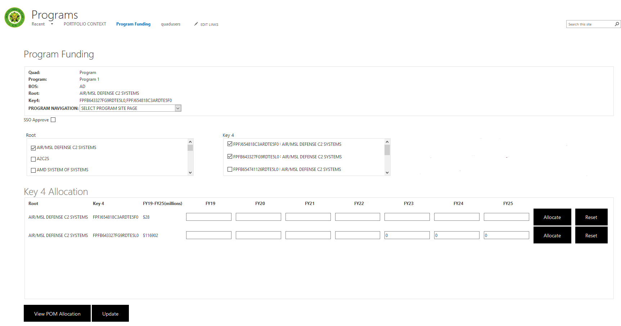
3. SSO Assigns/Updates Funding for Program
SSO Assigns and Update Key 4s for Program
SSO Splits Key 4s for Program’s FYs
SSO View FY POM Allocation and Update Program

Slide 7
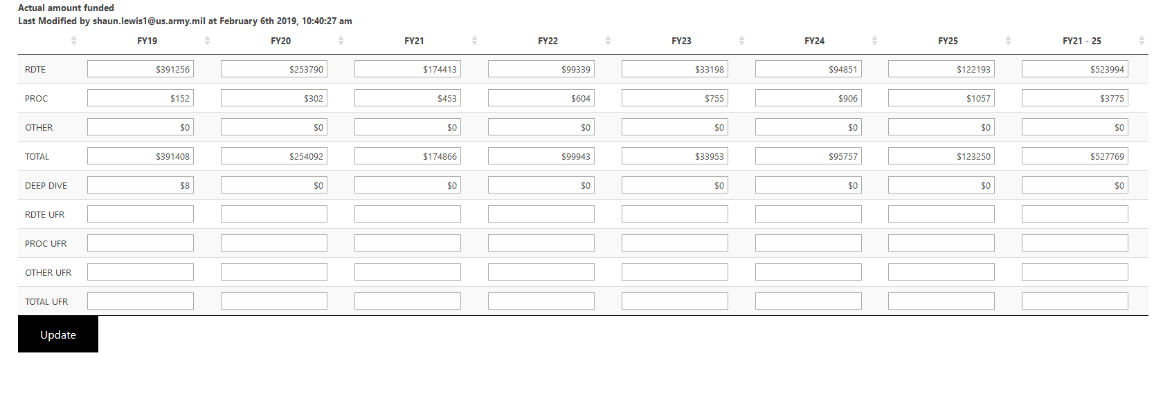
3. SSO Assigns/Updates Funding for Program(cont...)
SSO Views FY POM Allocation in Modal Box and Date Modified

Slide 8
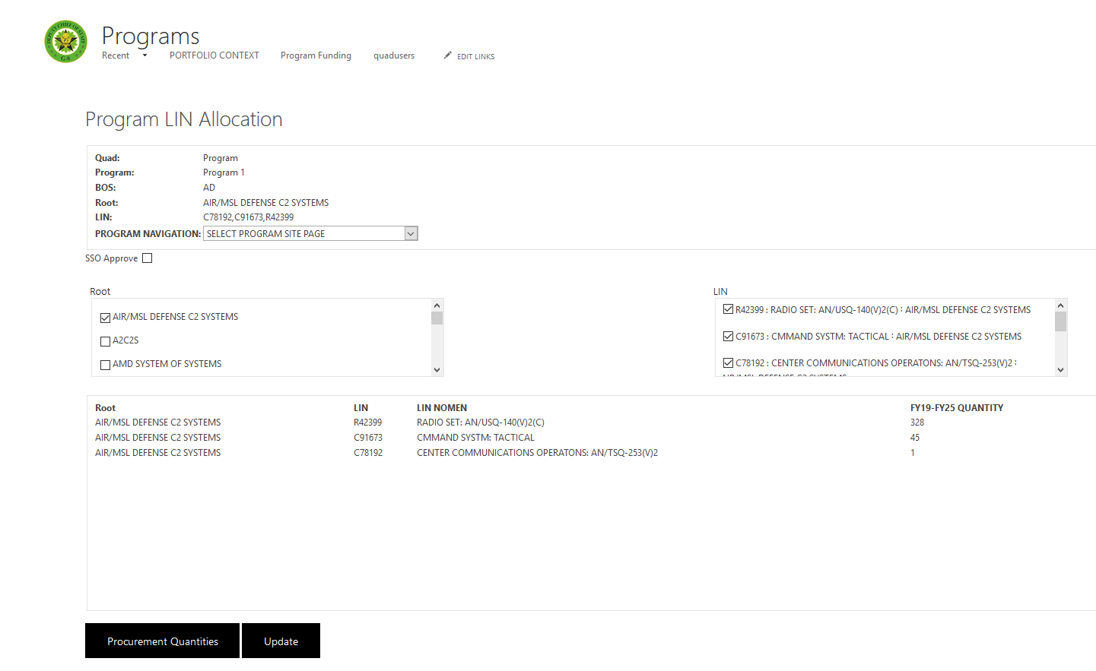
4. SSO Assigns/Updates Procurement Quantities for Program
SSO Assigns LINs for Procurement Quantities to Program
SSO View Procurement Quantities and Update Program

Slide 9
4. SSO Assigns/Updates Procurement Quantities for Program(cont...)
SSO Views FY Procurement Quantities in Modal Box and Date Modified

Slide 10
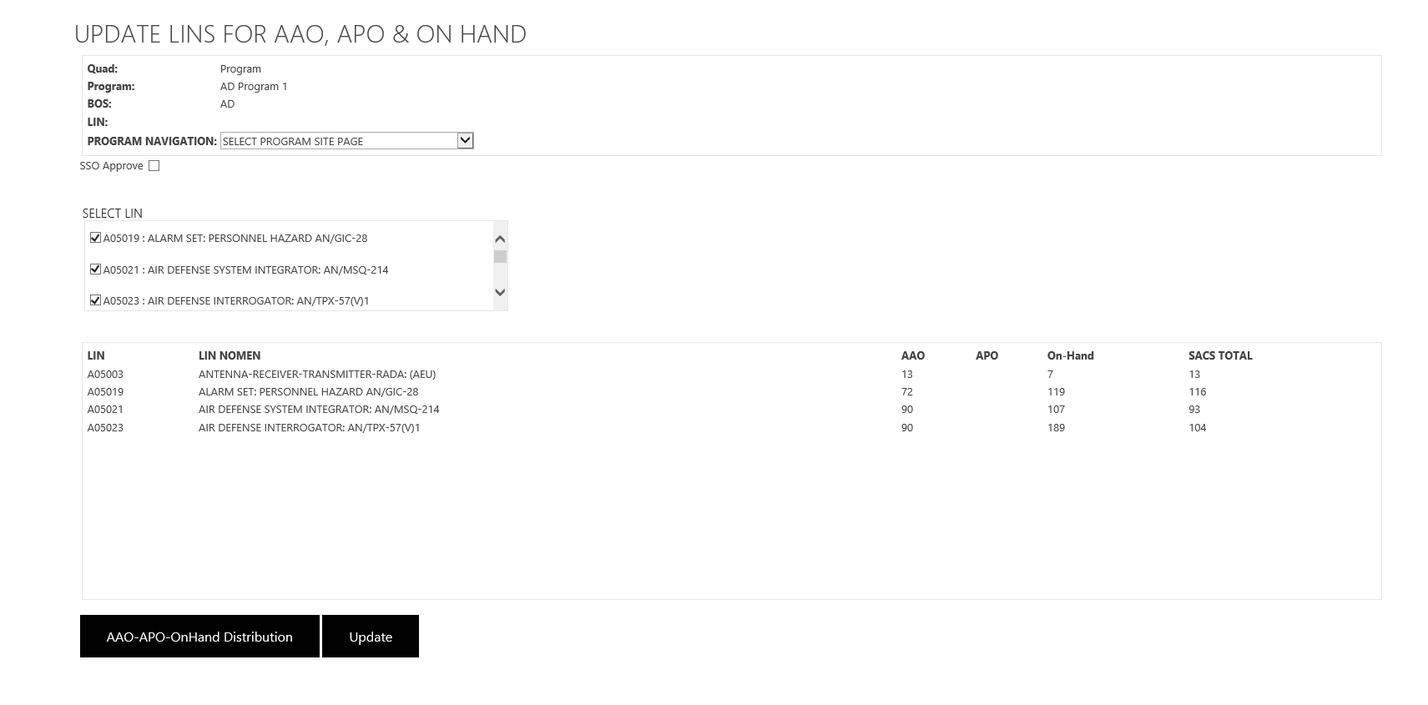
5. SSO Assigns/Updates AAO, APO, Inventories for Program
SSO Selects LINs for AAO-APO-Inventories
SSO View AAO-APO-Inventories and Update Program

Slide 11
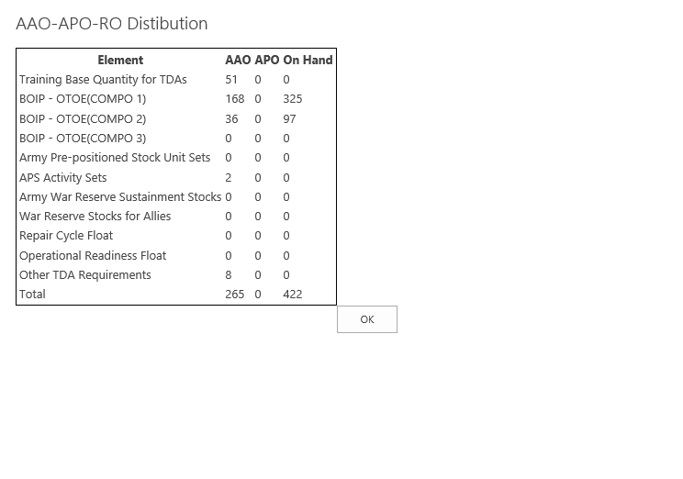
5. SSO Assigns/Updates AAO, APO, Inventories for Program(cont...)
SSO Views AAO-APO-Inventories Modal

Slide 12
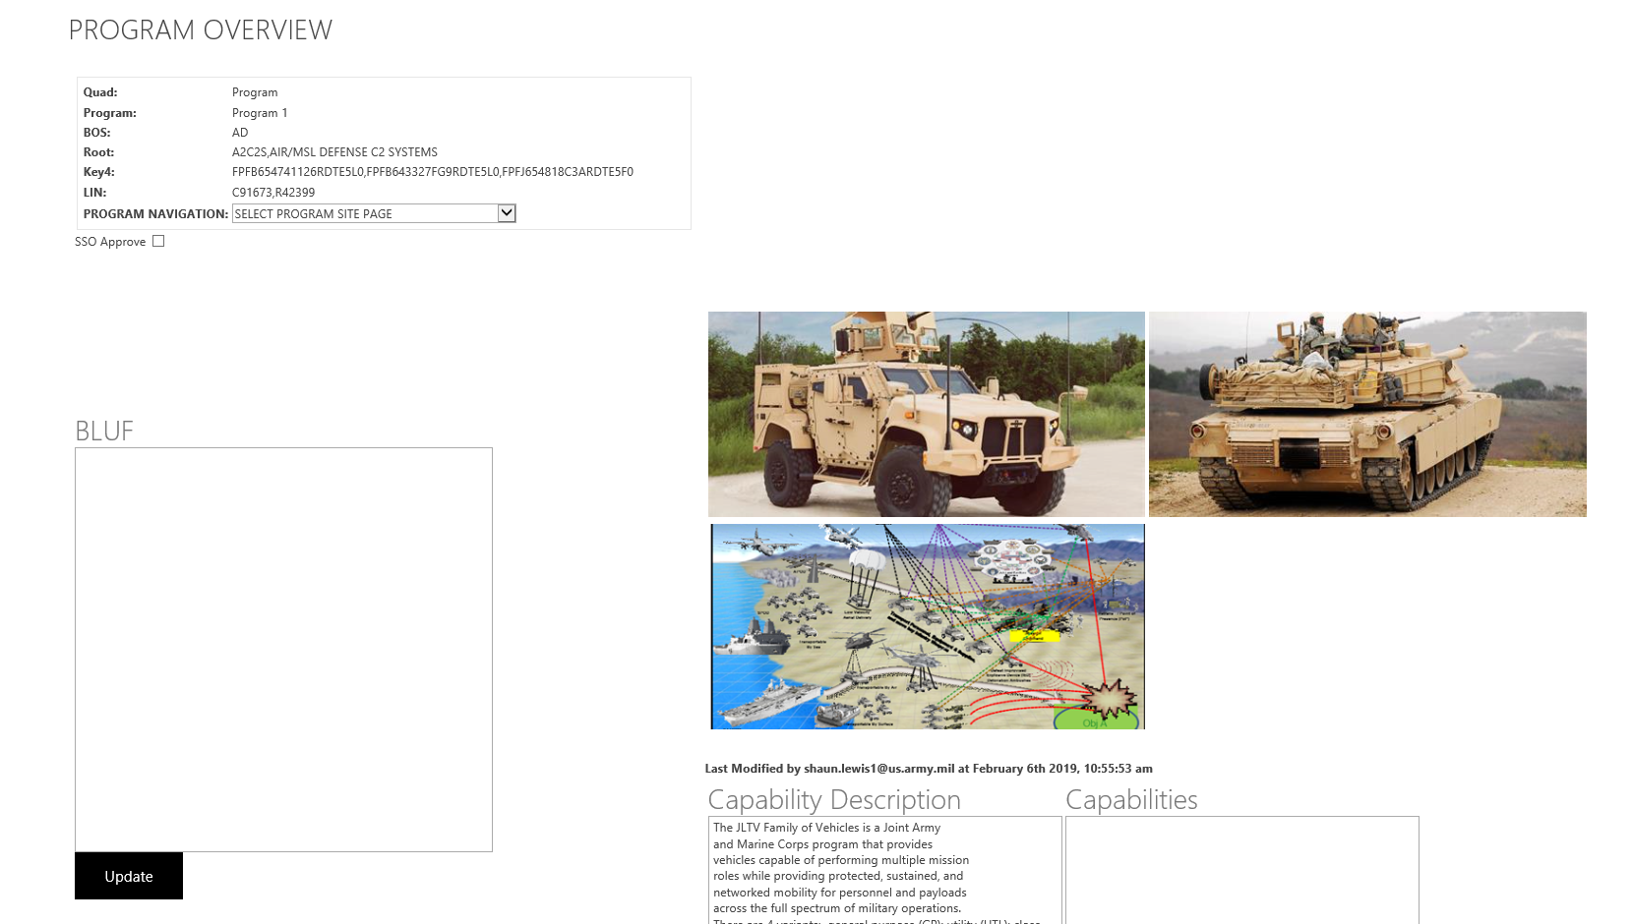
6. SSO Updates Sections of Program Quad
SSO Have the Option to Navigate to Different Sections
Of Program Quad Within SharePoint Site
SSO Updates Program data within SharePoint site

Slide 13
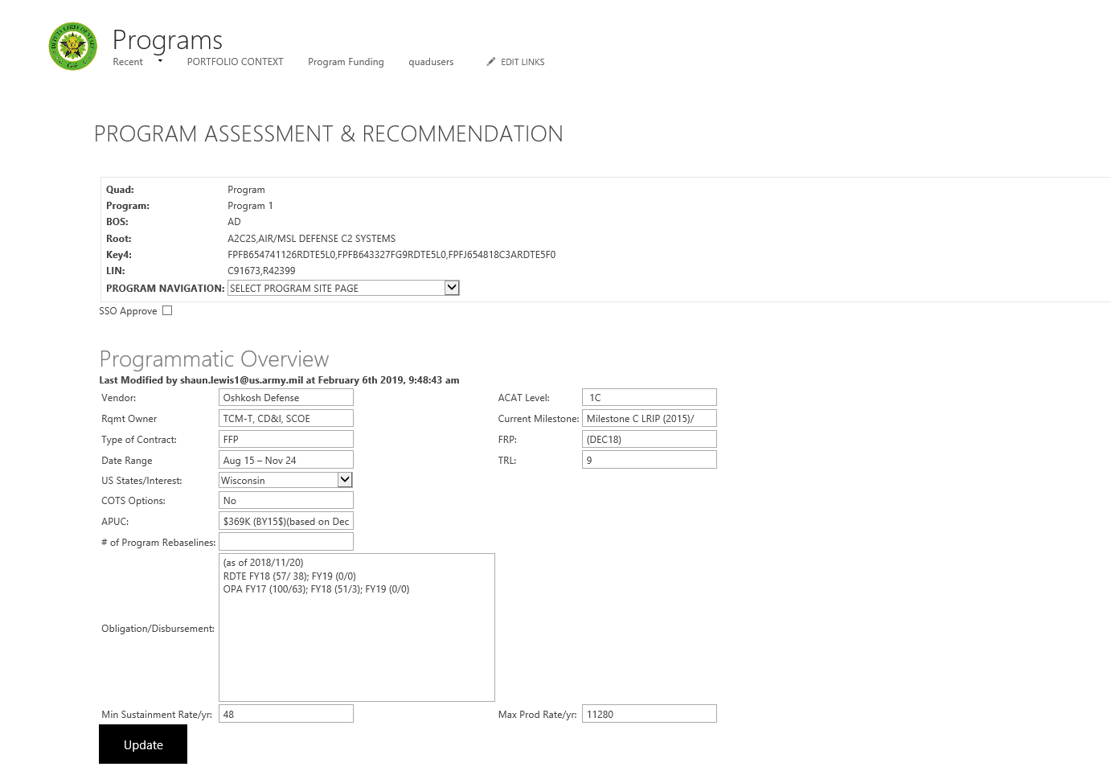
6. SSO Updates Sections of Program Quad(cont...)

Slide 14
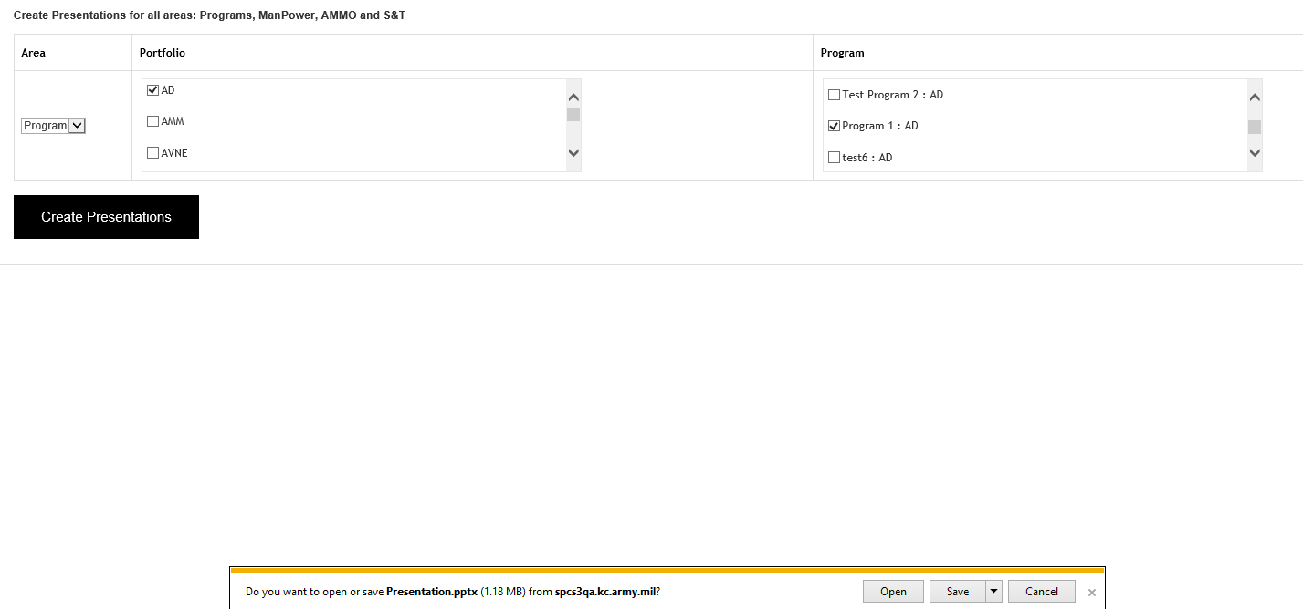
7. SSO Downloads Program PowerPoint Slides
SSO Selects Portfolio and Downloads Program Presentations from SharePoint Site

Slide 15
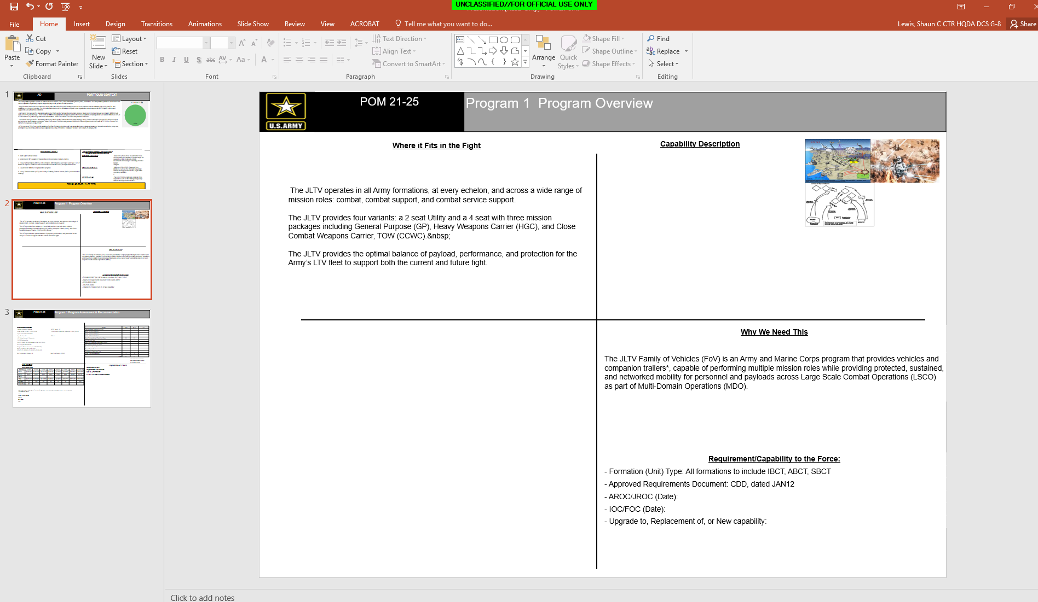
7. SSO Downloads Program PowerPoint Slides(cont...)
Program Data is Stream from SharePoint to PowerPoint

